Slide 1


LANL Team Project Update
4/2/2025
Izzy Baumler, Dalton Boeckmann, Morgan Gullo, Jade Waldron

Slide 2
Problem Statement/Project Motivation
There is a need for a technology that has 5 DOF and can move through its full range of motion in each degree of freedom of at least 1 Hz.

Slide 3
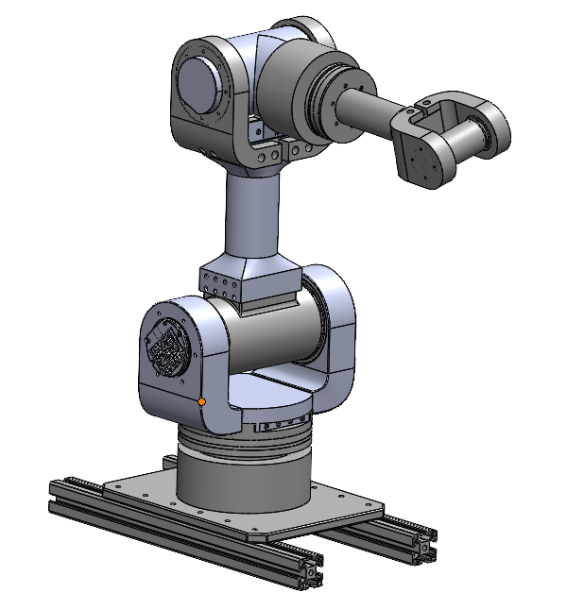
Weekly Assigned Tasks
Jade - Solidworks Refinement/Prototyping/Assembly
Izzy - Motor Research and testing
Dalton - Assembly/Motor Testing
Morgan - Purchase Orders/Electrical

Slide 4
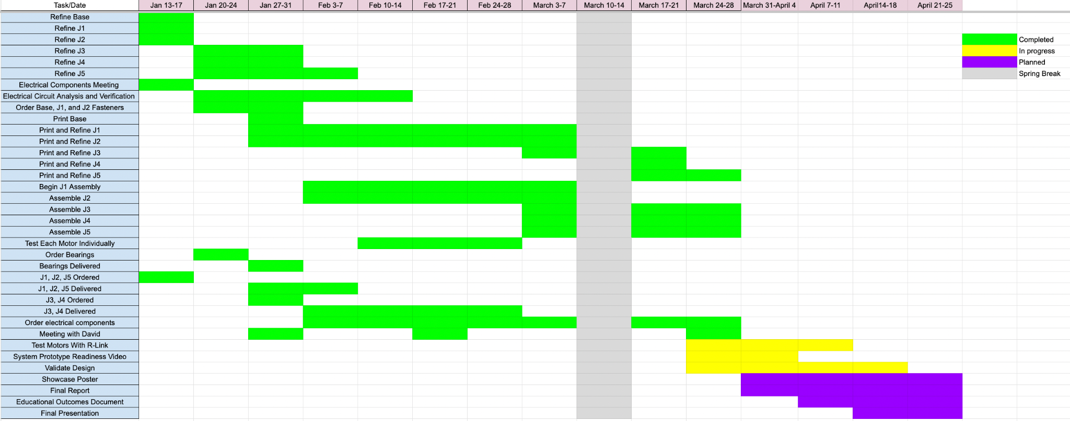
Schedule Update

Slide 5
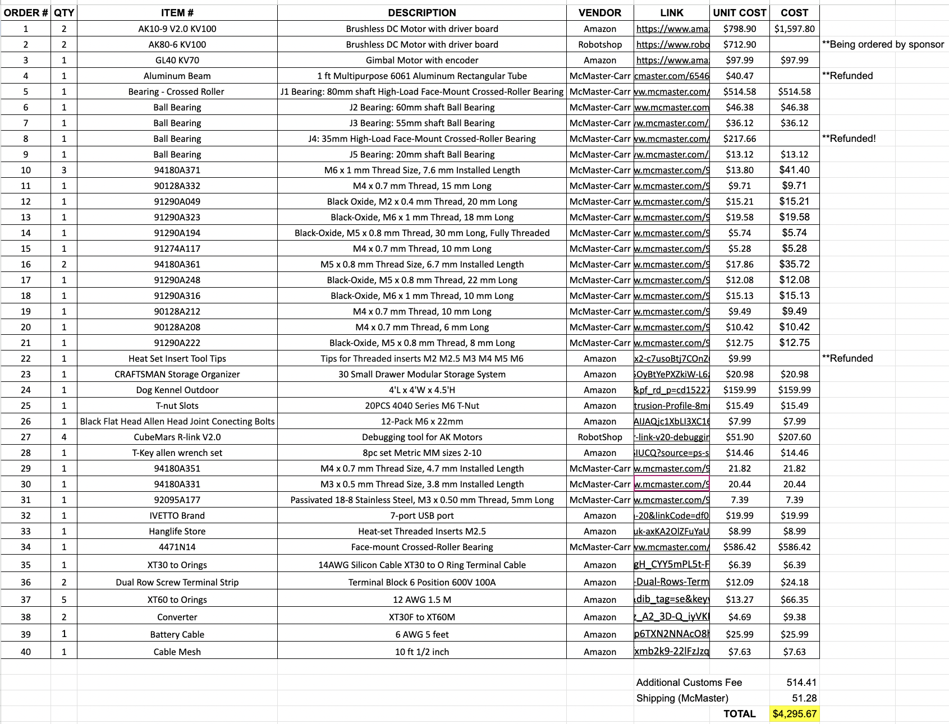
Budget Update

Slide 6
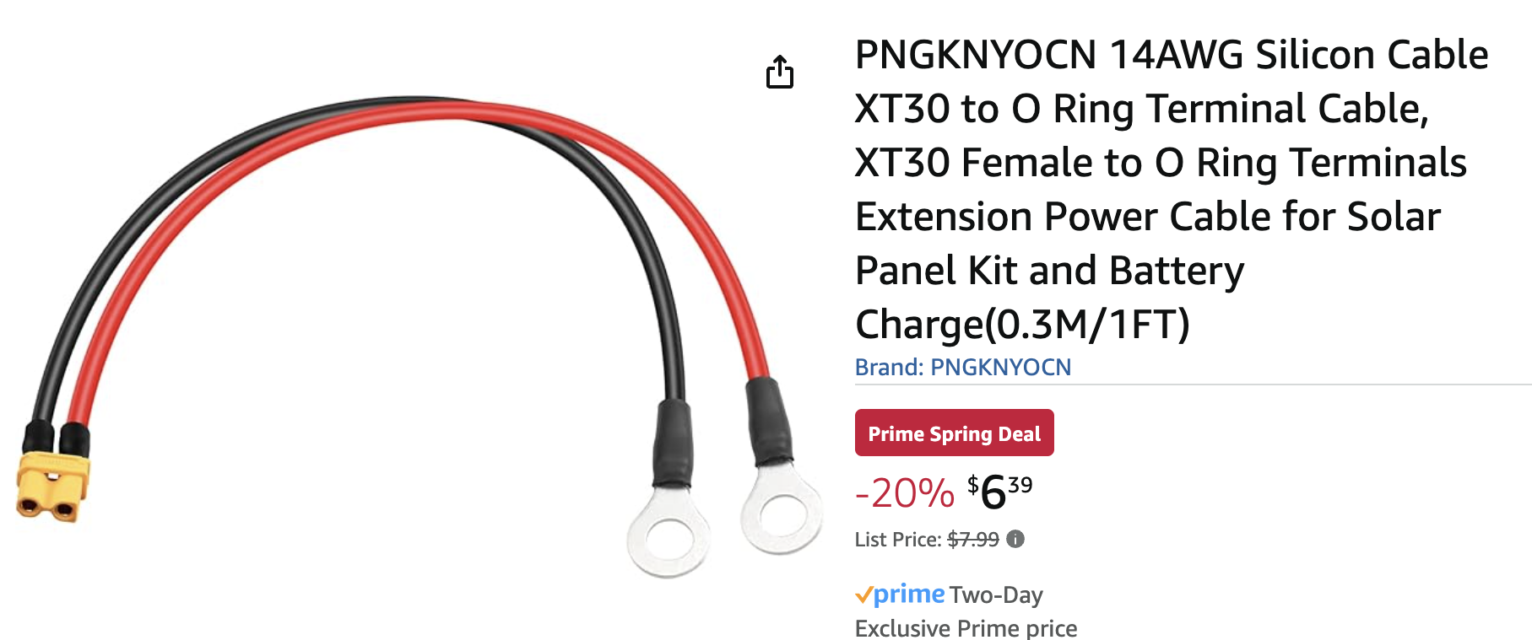
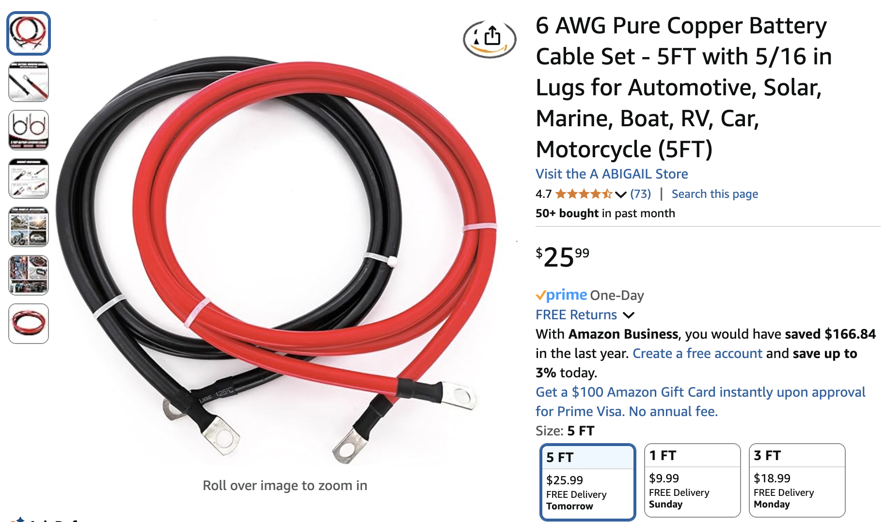
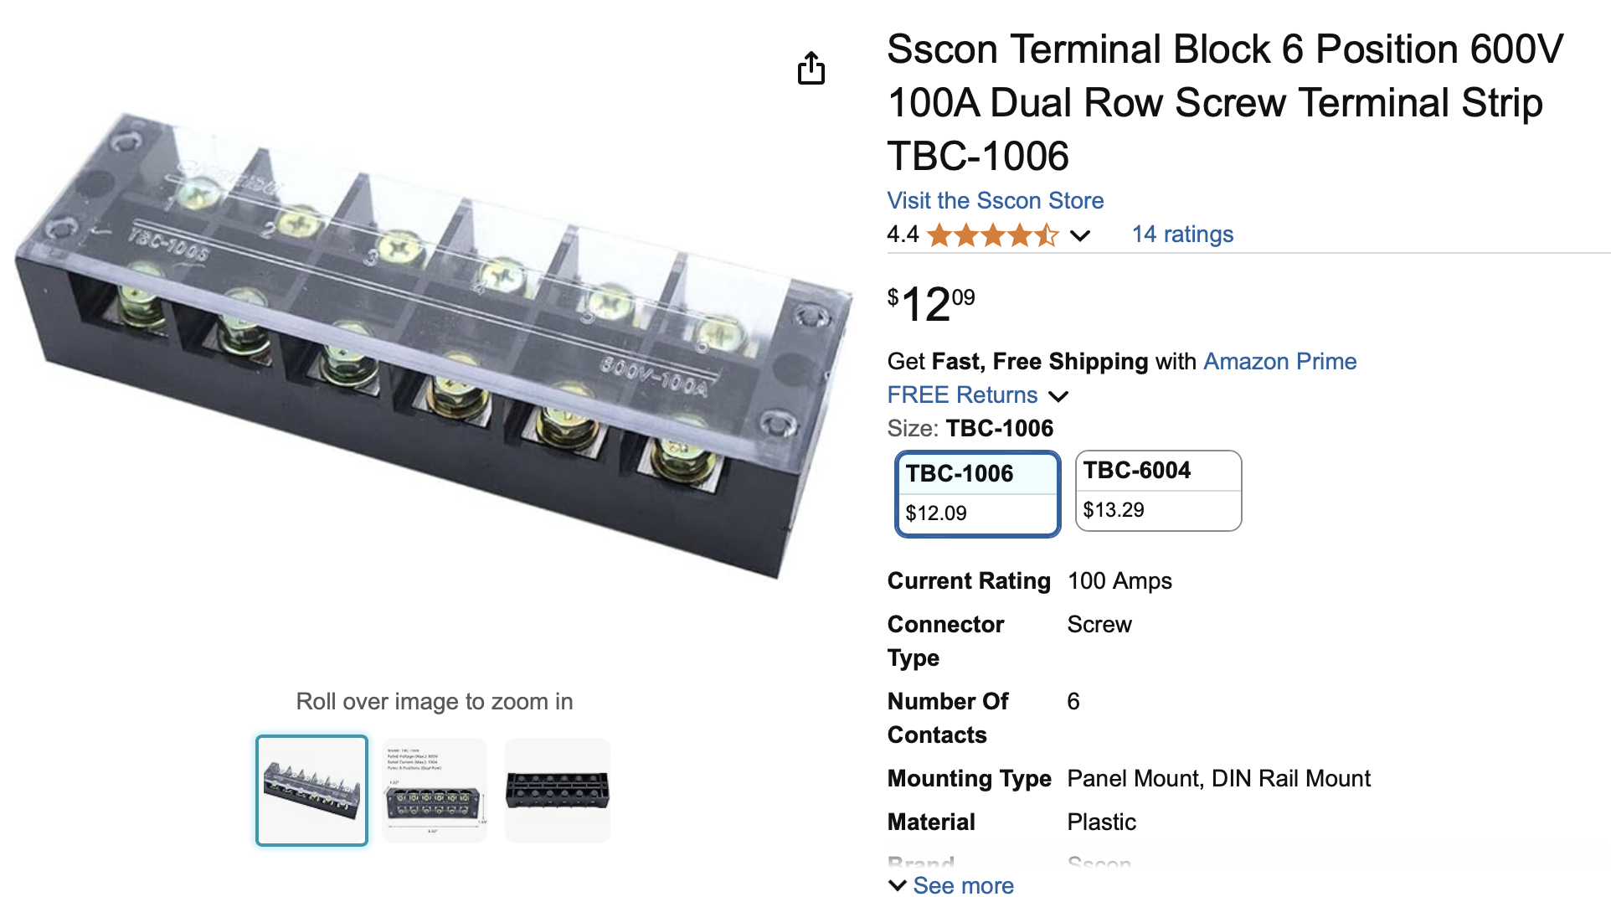
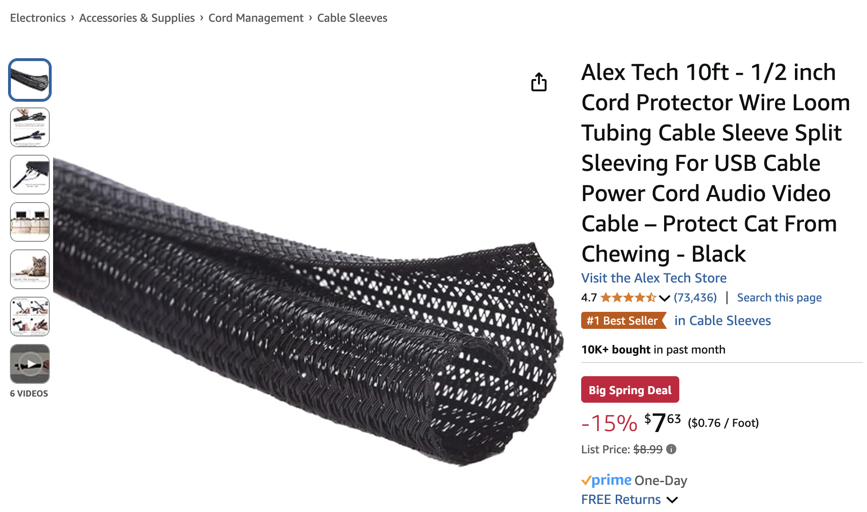
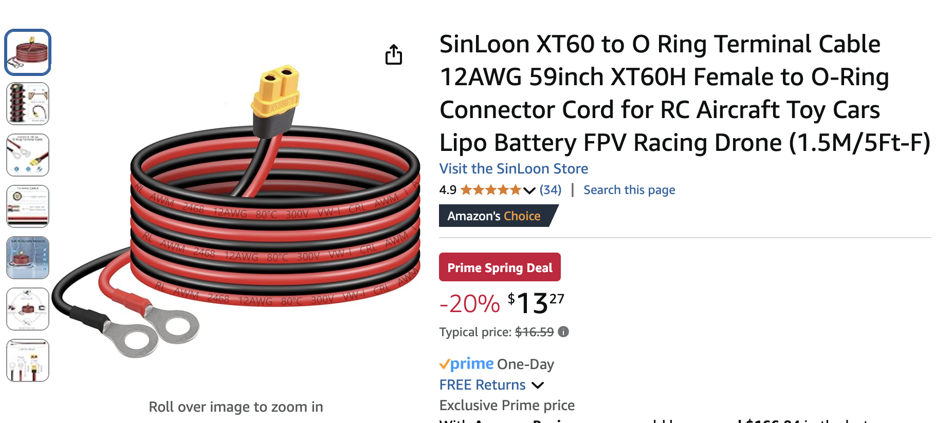
Orders Update

Slide 7
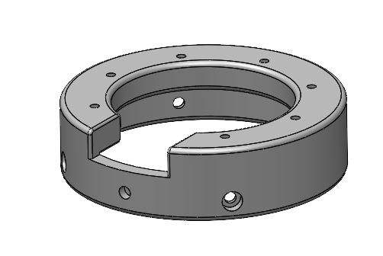
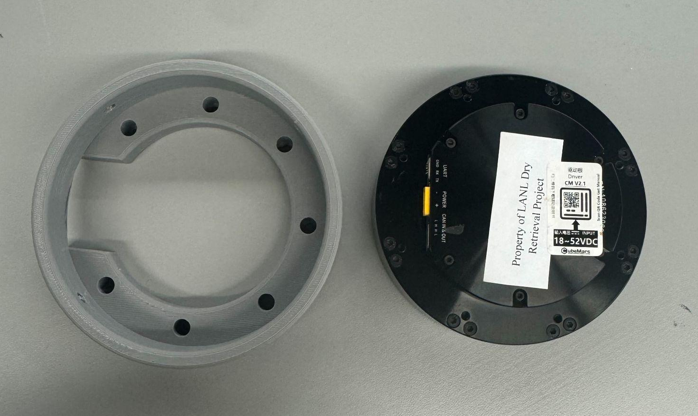
Prototyping
J4 Motor Holder
Needed Holes for Heat set inserts to fasten Motor Cover down since it was moving

Slide 8
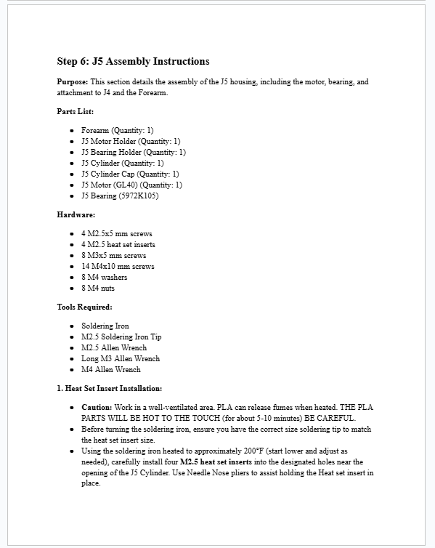
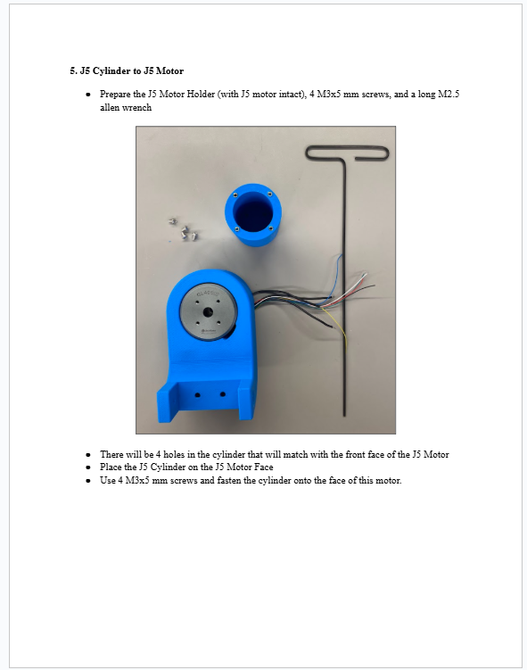
Assembly Manual
Assembly Manual 95% complete
~60 pages long (lots of figures, cover pages, etc…)

Slide 9
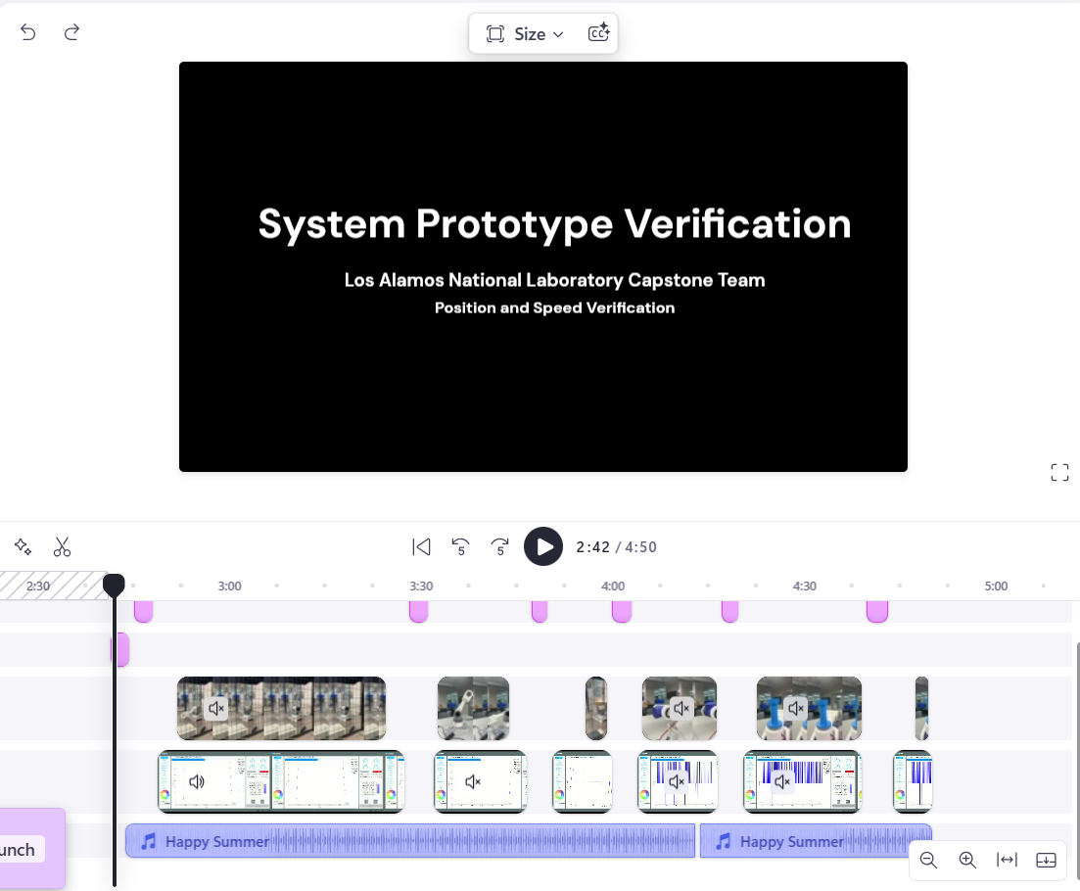
Testing
Positional and speed tests have been conducted for J1 through J4.
Tested positions include 90° and 180° ( J1 - 360°)
Speed was set to 1 Hz, equivalent to 6.28 rad/s
Working to finalize our Video for System Prototype Readiness

Slide 10
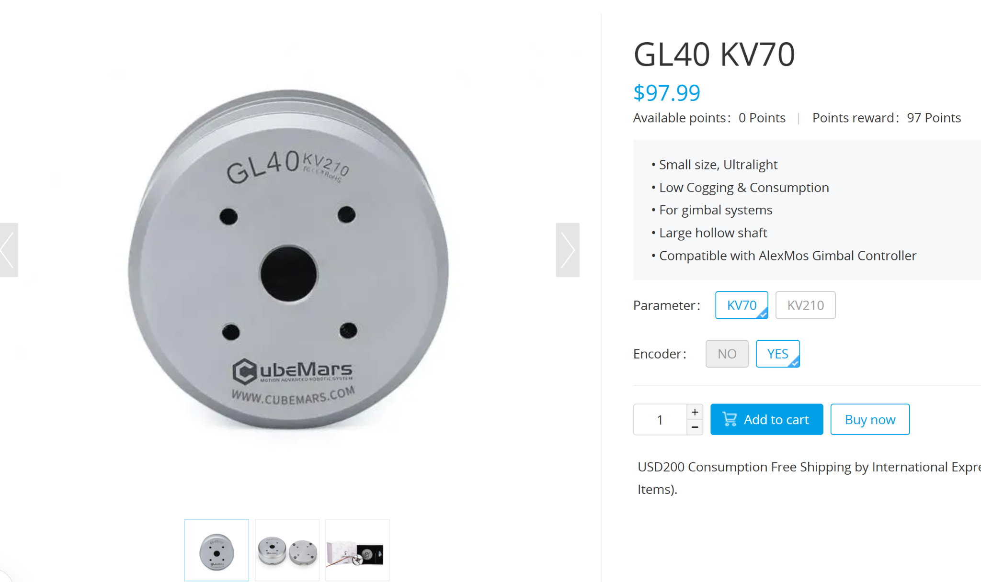
Testing
Testing final J5 motor
Part of Gimbal motor series so it requires different implementation from the AK series

Slide 11
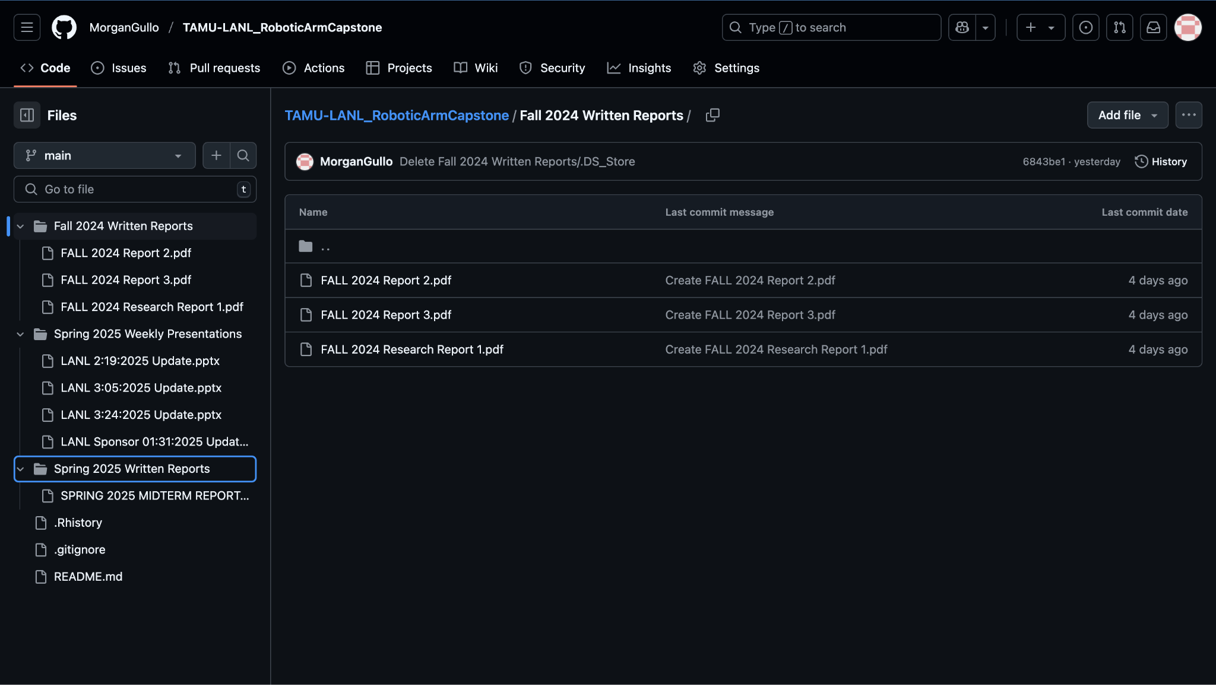
Github

Slide 12
Future Work
Verify electrical components
Test motors from common hub
Continue Assembly Manual changes and updates
Film milestone video
Continue GitHub repository to streamline and document the assembly process
Work on Final Report, Final Presentation, and poster
Final Presentation April 24th 5:00 - 6:00 PM

